Slide 1
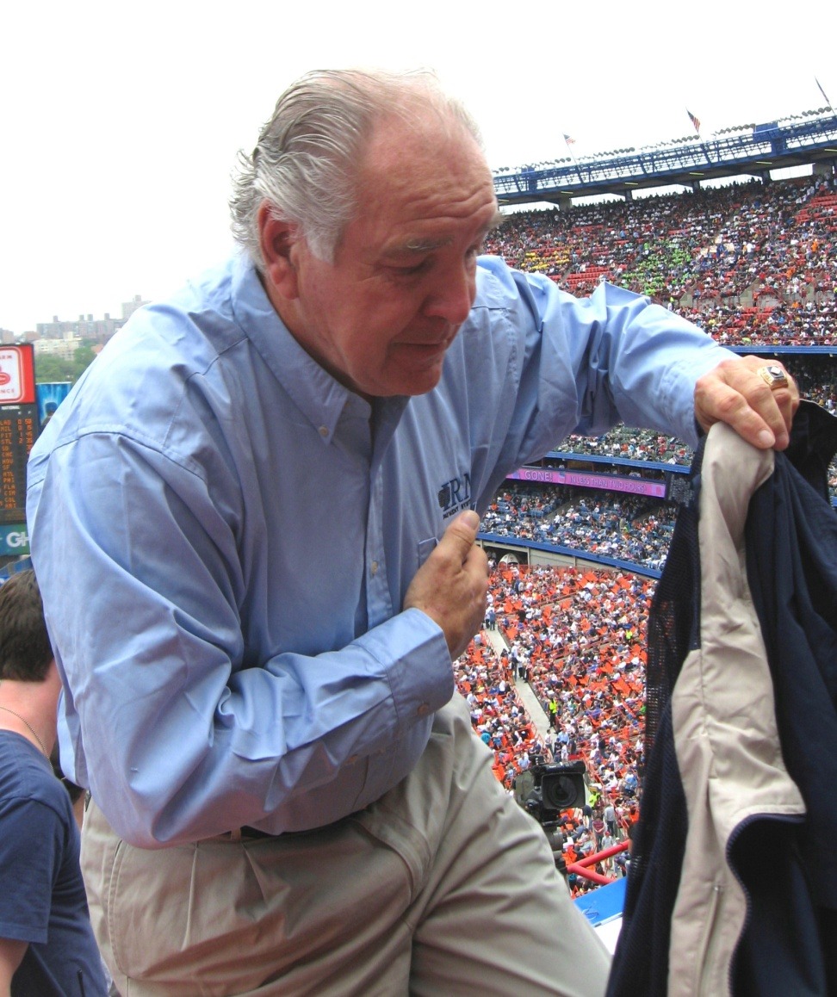
Cardiac Emergencies

Slide 2
Cardiac Emergencies
Introduction
  Why is the heart so important?
  What happens when the heart
stops?
If the heart does not function properly a person will die
The quicker a rescuer can identify a heart related emergency, the more likely the person will survive

Slide 3
Cardiac Emergencies
Students will be able to:
Understand how to prevent heart disease
Recognize signs and symptoms of a heart attack
Provide care for a heart attack victim
Understand importance to each link in the Cardiac Chain of Survival

Slide 4
Cardiac Emergencies
Terminology
Cardiovascular/Heart Disease
Leading cause of death in the United States. Caused by lifestyle factors and/or genetics

Slide 5
Cardiac Emergencies
Terminology
Cardiac Chain of Survival
Early recognition/care of heart attack symptoms, and early access to advance medical care. These steps increase the chance of a victim’s survival.

Slide 6
Cardiac Emergencies
Terminology
Heart attack
Heart muscle is damaged from a lack of oxygen & blood supply due to disease or trauma

Slide 7
Cardiac Emergencies
Terminology
Cardiac Arrest
Heart stops beating effectively and blood is no longer circulating.

Slide 8
Cardiac Emergencies
Terminology
CPR-CardioPulmonary Resuscitation
A combination of chest compressions and breaths to provide oxygen to the tissues when the heart is unable to do so.

Slide 9
Cardiac Emergencies
Terminology
AED
Automated external defibrillator
Delivers an electric shock to the heart (defibrillation)

Slide 10
Cardiac Emergencies
Terminology
Defibrillation
Re-establishing a normal effective heart rhythm in an individual who is in cardiac arrest

Slide 11
Cardiac Emergencies
Terminology
Atherosclerosis
Build up of fatty substance on the inner walls of the arteries caused by Cholesterol
A cause of cardiovascular disease

Slide 12
Cardiac Emergencies
Heart disease is the leading cause of death in the United States in both men and women!
Taking steps to prevent heart disease is one of the most important things you can do for your health.

Slide 13
Cardiac Emergencies
Get into groups of 3 and brainstorm:
What are the causes of Cardiovascular Disease.
What are the Lifestyle factors that influence Cardiovascular Disease?

Slide 14
Cardiac Emergencies
Causes of Cardiovascular Disease:
Heredity
Age
High Cholesterol levels
High Blood pressure
Diabetes

Slide 15
Cardiac Emergencies
Lifestyle Factors that influence Cardiovascular Disease:
Diet
Smoking
Exercise
Weight control
Drugs and Alcohol

Slide 16

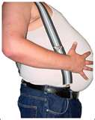

Cardiac Emergencies- Lifestyle
Diet/weight control
Smoking
Exercise
Drugs/Alcohol

Slide 17
Cardiac Emergencies
Learn to recognize the early signs of a heart attack and take action!

Slide 18
Cardiac Emergencies
A person suffering a heart attack still has a beating heart, but due to blockage of heart blood vessels, is not working properly.

Slide 19
Cardiac Emergencies
In your same group of 3 brainstorm:
What are the signs & symptoms of a heart attack?

Slide 20
Cardiac Emergencies
Signs & Symptoms of a heart attack:
Most prominent symptom is persistent chest pain or discomfort
Many victims deny that they are having a heart attack

Slide 21
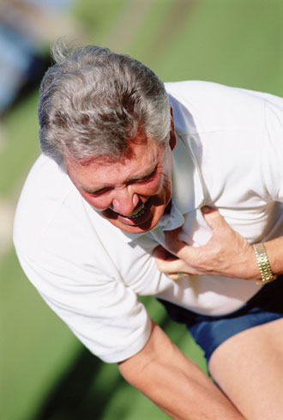
Cardiac Emergencies
Signs & Symptoms:
Chest Discomfort and Pain
Pressure
Squeezing
Tightness
Aching
Constricting
Heavy
sensation

Slide 22
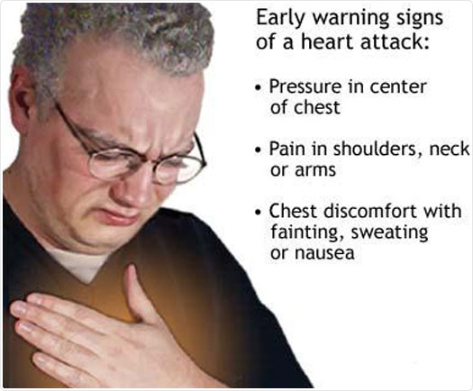
Cardiac Emergencies
Chest Pain
Anything from mild discomfort to unbearable crushing sensation

Slide 23
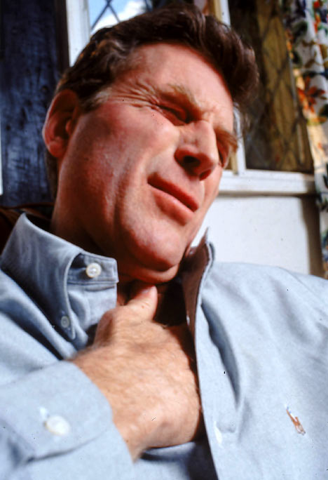
Cardiac Emergencies
Chest Pain
May start as pressure under the sternum
Can spread to neck, shoulder, arms, jaw or back

Slide 24
Cardiac Emergencies
Signs & Symptoms
Sweating
Shortness of breath/trouble breathing
Nausea
General ill feeling

Slide 25
Cardiac Emergencies
4 links to cardiac chain of survival
Early recognition and action of EMS
  The quicker the symptoms of a heart attack are recognized, the quicker 911 can be called
  The quicker a heart attack victim can receive care, the more likely they are to survive

Slide 26
Cardiac Emergencies
4 links to cardiac chain of survival
Early CPR
  When the heart stops the person is in cardiac arrest
  CPR is the method of providing chest compressions & breaths to circulate oxygenated blood to the tissues to prolong life

Slide 27
Cardiac Emergencies
4 links to cardiac chain of survival
Early CPR
  Used until an AED is available or further medical care can be provided
  The quicker CPR is started, the better the chance of survival

Slide 28
Cardiac Emergencies
4 links to cardiac chain of survival
Early AED
  Needed by most victims in cardiac arrest
  An electrical shock to the heart which establishes normal, effective heart rhythm again
  The earlier the better

Slide 29
Cardiac Emergencies
4 links to cardiac chain of survival
Early Advance Medical Care
  The quicker EMS is initiated, the quicker the victim will have access to medication & advanced medical care
  Provided by EMT’s & paramedics
  Transportation to hospital

Slide 30
Cardiac Emergencies
4 links to cardiac chain of survival
Early recognition and action of EMS
Early CPR
Early AED
Early Advance Medical Care
Each link is dependent & connected to other links

Slide 31
CPR
Combination of chest compressions & breaths
One cycle consists of 30 chest compressions followed by 2 ventilations
5 cycles every 2 minutes
100 chest compressions per minute
  30 compressions in 18 seconds

Slide 32
CPR
Start chest compressions ASAP and do quickly
Tune of the song “Staying Alive” or “Another One Bites the Dust”
Each breath should be about 1 second in length
Each breath should make the victim’s chest rise & fall

Slide 33
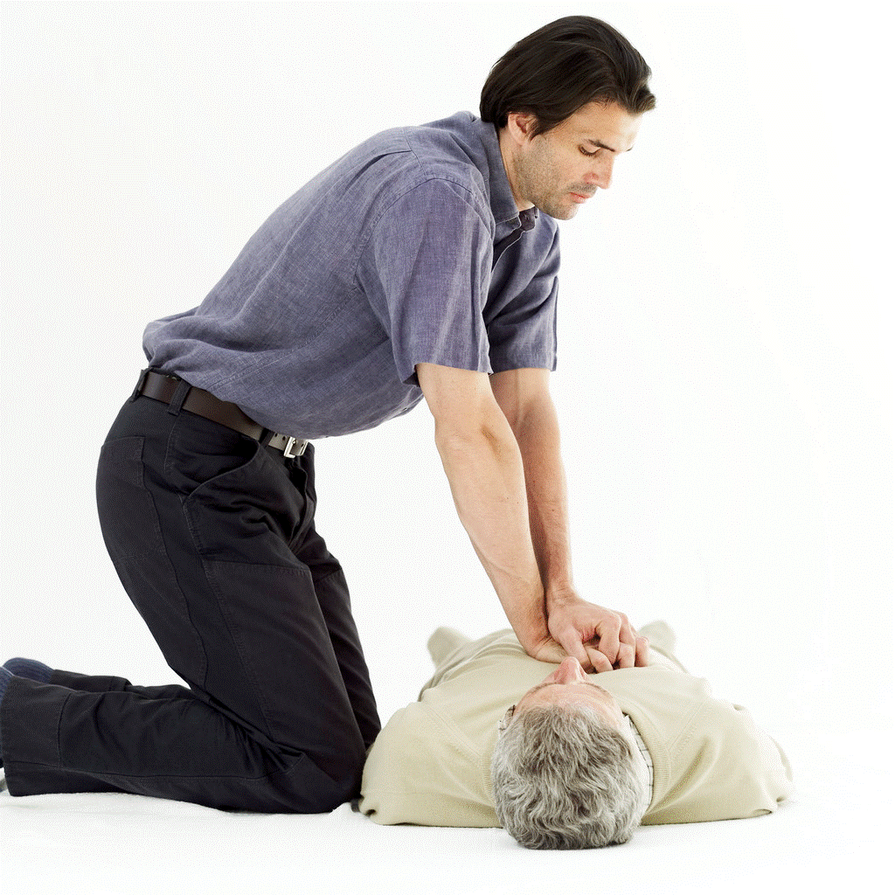
CPR - Adult
Victim must be:
Flat on back
On a hard surface
Rescuer
Kneel at the side of victim
  With your Gluteus maximus off your heels

Slide 34
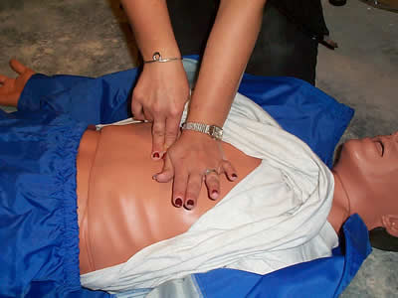
CPR - Adult
Find the Xiphoid Process
Place 2 fingers on the Xiphoid Process
Put other hand superior to fingers on sternum
Hand Placement

Slide 35
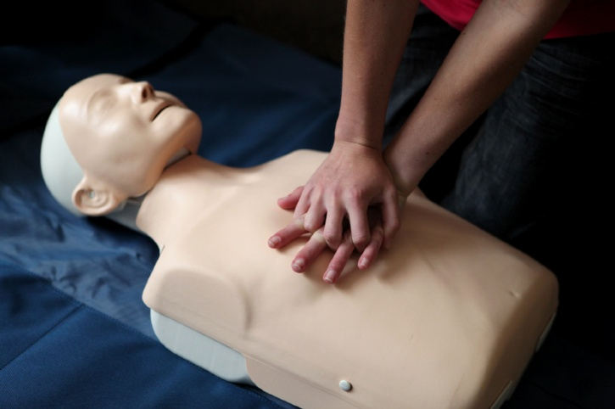
CPR - Adult
Bottom hand
Heel of hand on sternum
Place other hand on top of bottom hand
Keep fingers off chest
  Interlock fingers
Hand Placement

Slide 36
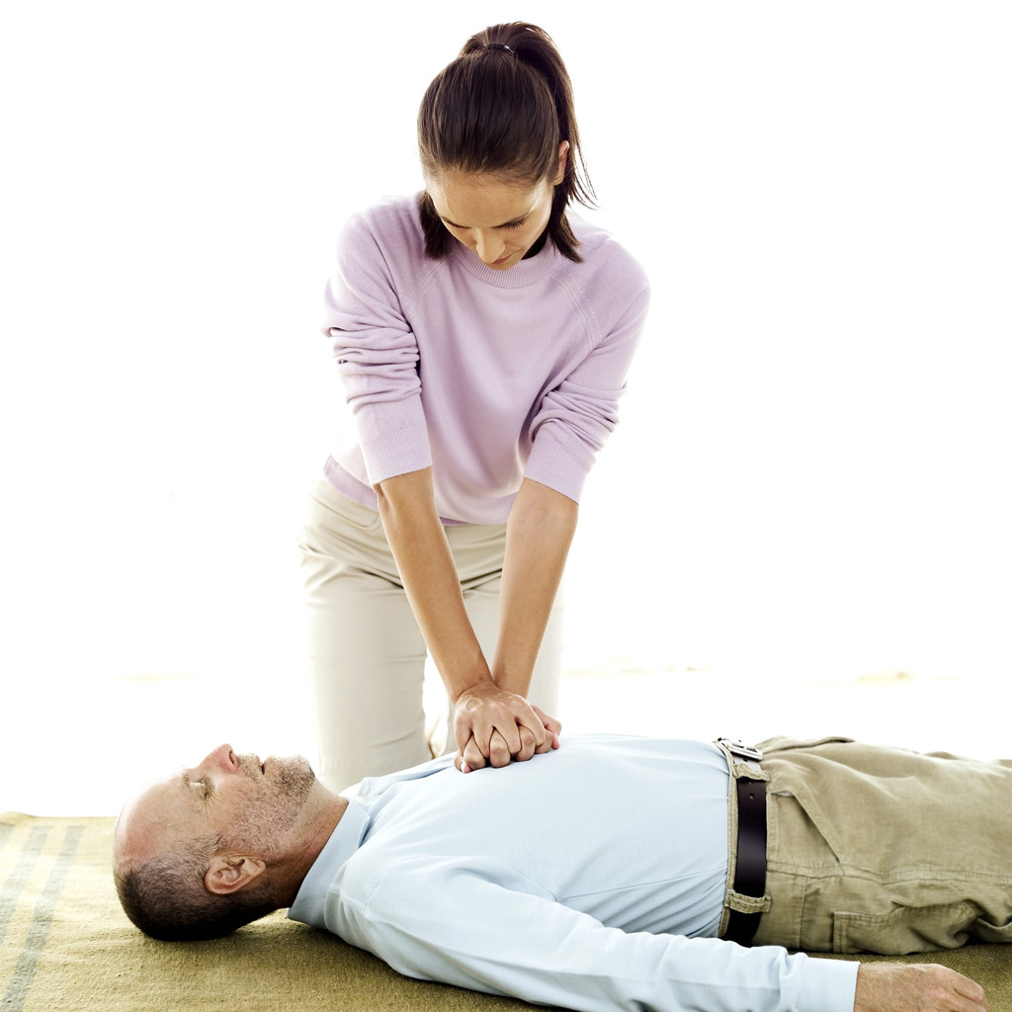
CPR
Elbows locked out
Shoulders directly over the Victim
Rock at the Hips

Slide 37
CPR - Adult
Adult CPR:
2 hands over lower half of sternum
Compress victim’s chest 1 1/2 “ – 2”
Breathe until chest rises
  About 1 second per breath
30 compressions : 2 breaths
30 compressions per 18 seconds
  100 compressions per minute

Slide 38
Child and Infant CPR
Child CPR:
1 or 2 hands on lower half of sternum
Compress victim’s chest 1-1 ½ inches
Breathe until chest rises
  About 1 second per breath
30 compressions : 2 breaths
30 compressions per 18 seconds
  100 compressions per minute

Slide 39
Child and Infant CPR
Infant CPR:
2 or 3 fingers just below nipple line
Compress victim’s chest ½ - 1 inch
Breathe until chest rises
  About 1 second per breath
30 compressions : 2 breaths
30 compressions per 18 seconds
  100 compressions per minute

Slide 40
CPR
When do you Stop
Victim Shows signs of life
Scene becomes unsafe
AED is ready to use
Another trained person can take over or EMS arrives
Rescuer is too physically exhausted to continue

Slide 41
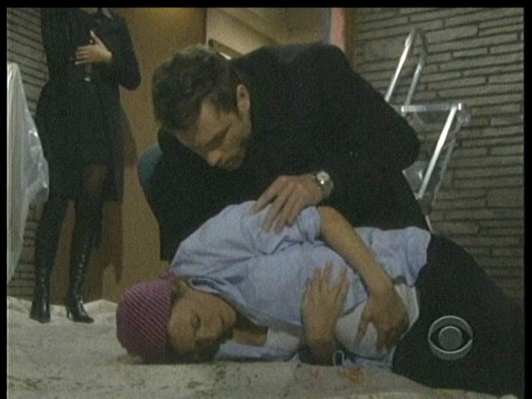
CPR
Check Scene
Safe – Unsafe
Check Victim
Consciousness
Airway – Open - head tilt, chin lift
Breathing – Look-Listen-Feel – 10 sec
Circulation – Pulse – carotid/brachial
Call 911
Care

Slide 42
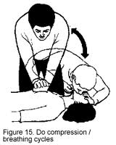
CPR
Care
Give 2 rescue breaths
Give 30 chest compressions
  Complete 5 cycles (2 minutes)
  Re-Check ABC’s

Slide 43
CPR
*CPR – Adult - 1:00 - http://www.youtube.com/watch?v=2Oc7LWNHgm4&feature=related
*CPR – Child – :54 - http://www.youtube.com/watch?v=SvmzWOuFWKM&feature=related
*CPR – Infant – :40 - http://www.youtube.com/watch?v=kfxeOP4ILbA&feature=related

Slide 44
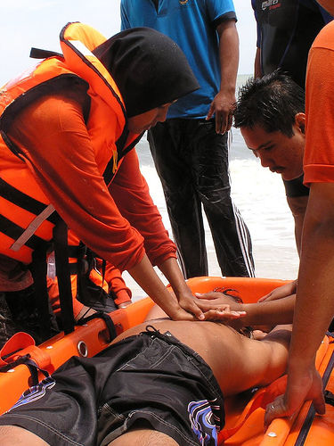
CPR
Get with your partner and perform CPR on the manikins
Remember to use breathing barriers and clean the manikins between users

Slide 45
CPR
Stayin Alive - Bee Gees - video - 3:55 - http://www.youtube.com/watch?v=IHWeuQyFouo&feature=list_related&playnext=1&list=MLGxdCwVVULXddklmvdOPrEiq6YQDt3CS9
Another One Bites the Dust - Queen - lyrics - 3:36 - http://www.youtube.com/watch?v=CWsJcg-g1pg

